Slide 1
Interview Judge Training

Slide 2
Welcome
Welcome to the United States Academic Decathlon® orientation session for interview judges.
We appreciate your willingness to volunteer your time to this academic competition. The United States Academic Decathlon® program strives to provide an opportunity for high school students to experience the challenge of rigorous academic competition.

Slide 3
Thank You!
Thank you again! Without you, this important competition simply could not occur.
Enjoy yourself. You are going to meet some amazing and impressive young people who are a testament to our schools and education systems.
Everyone at USAD appreciates your time and energy.

Slide 4
Academic Decathlon Goals
Promote wholesome interschool competition in academic areas of study
Stimulate intellectual growth and achievement
Strengthen students’ interpersonal communication skills
Encourage public awareness and interest in outstanding programs in our schools

Slide 5
USAD Objective Events
The USAD program provides a format in which high school students compete in 10 events.
Seven of the events are considered objective in nature. These events have written examinations.
The objective events include: art, economics, literature, mathematics, music, science, and social science.

Slide 6
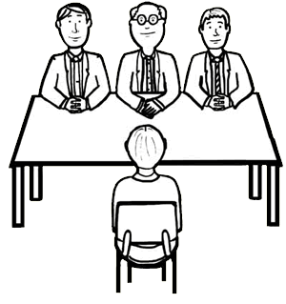
USAD Subjective Events
Three “subjective” events involve communication skills:
Speech
Interview
Essay

Slide 7
Super Quiz
The culmination of the competition is the “Super Quiz.” It is a stand-alone team event traditionally held before a large audience. Each of the three groups on a team answers 18 questions in a format similar to a quiz show.

Slide 8
Team Makeup
A team consists of nine students:
Three honor students with a 3.80 – 4.000 GPA
Three scholastic students with a 3.20 – 3.799 GPA
Three varsity students with a 0.00 – 3.199 GPA
Students may test “up” in a category above their qualifications…but not “down” in a lower one.

Slide 9
Orientation Purpose
The purpose of this orientation is to familiarize you with the Interview event, specifically.
An interview has two primary functions: to give information and to get information.
In the Academic Decathlon framework, the interviewing process involves a panel of judges posing questions to and eliciting responses from the decathlete.

Slide 10
The Interview
The general content of the provided interview questions will be based on:
Contest-related questions. Some questions will relate specifically to the Academic Decathlon competition, discussing topics such as preparation, events, struggles, and/or rewards.
Standard Interview Questions. Other questions may closely parallel those of a professional employment interview or admissions interview.

Slide 11
Interview Skills
The interview experience is designed as a teaching instrument to prepare students to present themselves in a positive manner. Interview skills include:
interpersonal skills
listening skills
answering skills

Slide 12
Objectivity and Balance
It is important that the interview event be as objective as possible.
All students must have an equal opportunity to express themselves on questions that provide a uniform basis for evaluation.
Questions are structured to provide each student with an opportunity to succeed in presenting themselves in a positive manner.

Slide 13
Judging Criteria
Students will be judged on their ability to:
Present ideas and responses that are appropriate to the setting and to the questions asked

Slide 14
Judging Criteria (cont.)
Listen to the comments and inquiries of the interviewers and elaborate with interesting detail and vivid impressions, while avoiding repetition.

Slide 15
Judging Criteria (cont.)
Establish and maintain rapport with members of the interview judging team through voice, gestures, and attitudinal.

Slide 16
Judging Criteria (cont.)
Use voice, vocabulary, and language structures appropriate to informal oral communication.

Slide 17
Interview Goal
Provide a setting that is conducive to the decathlete presenting their self to the best of their ability.
Remember: the students may be nervous and apprehensive. Put them at ease and make them feel comfortable as soon as possible.

Slide 18
Judging Responsibilities
The primary function of each interview panel is to conduct objective, consistent, and uniform interviews.
The panel should maintain a balance of question content.
Each judge should be involved in asking questions.
Each judge should be personable, attentive, and responsive to each student’s comments.

Slide 19
Judging Responsibilities (cont.)
Ask a balance of questions from the Interview Question document.
Do not argue, interrupt, or display authority that puts a student on the defensive.
Be an active listener.
Listen not only to what is being said, but also observe how it is said.
Be aware of the tone of voice, the use of facial expressions and gestures, and the overall physical demeanor of the student.

Slide 20
Judging Responsibilities (cont.)
Note also the vocabulary, sentence structure, and coherence of the response and the appropriateness of all to the question posed.
Allow the student to complete their comments before moving to the next question or ending the interview.
Although judges should not interrupt a student or overtly control the length of a student’s response, sometimes a gentle nod or a smile will serve to move the interview along.

Slide 21
Judging Responsibilities (cont.)
Refrain from initiating questions regarding:
race
creed
ethnic groups
national origin/ancestry
political beliefs or affiliations
religious doctrine

Slide 22
Judging Responsibilities (cont.)
KEEP ON SCHEDULE!
12 minutes are allotted per student:
2-minute preparation time between interviews
7-minute interview time
3-minute evaluation time following the interview

Slide 23
Judging Responsibilities (cont.)
AFTER the student leaves the room, rate the student’s interview performance using the Google form provided and according to the ten categories of communication skills listed on the official US Academic Decathlon Interview Evaluation Form.
Note: It is distracting to the student to be rated while he or she is speaking.

Slide 24
Before the Interview Begins
As an interview panel, determine who will:
Greet the student
Ask the first question

Slide 25
Interview Question document
USAD provides a question document to be used in conducting student interviews. Before the interviews begin, the judging panel should select/assign interview questions to each judge; i.e., Judge 2 will ask Questions 1, 4, 7, 10; Judge 3 will ask Questions 2, 5, 8, 11; and Judge 1 will ask Questions 3, 6, 9, 12.
Questions MUST be asked in the same order for every student to assure that students are judged on their responses to the same queries.

Slide 26
Sample Past Questions
What process are you using to select a college, career, or job?
What made you decide to participate on your Academic Decathlon team?
How has the Academic Decathlon experience affected you?
Who is or has been the most influential person in your life and why?

Slide 27
Interview Google Form
All scores must be submitted on the official USAD Interview Google Form (screenshots follow).
Consistently and accurately indicate on each form your assigned: Table/Room number and Judge number
Be certain the student’s 4-digit number is accurately entered on the form (verify this between the schedule and the student ID upon arrival and all prior to entering it on the form)

Slide 28
Interview Google Form (cont.)
Each member of a judging team MUST submit one Interview Evaluation Google form for each decathlete who appears and competes.
NO forms are completed for students who are “no shows.”

Slide 29
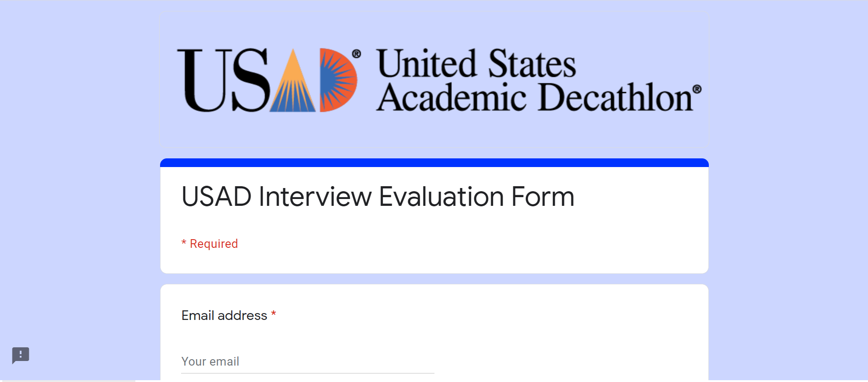
Google Scoring Document Enter Your Email Address

Slide 30
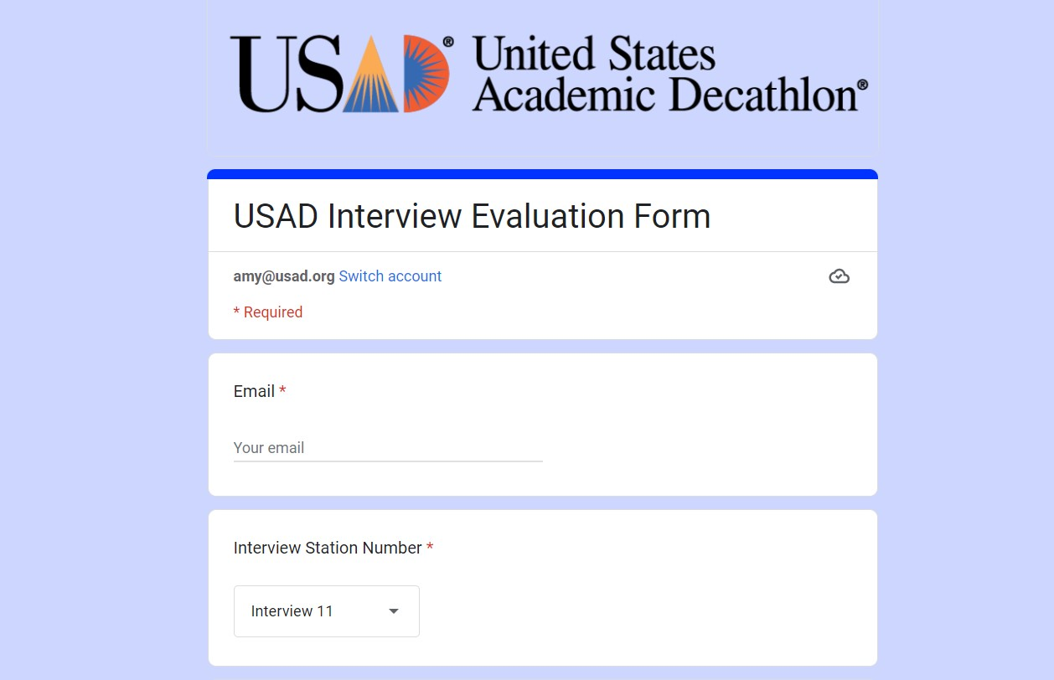
Select Interview Station Number

Slide 31
Enter Judge Name and Number (assigned by USAD)

Slide 32
Enter Student ID number Select “Next”

Slide 33
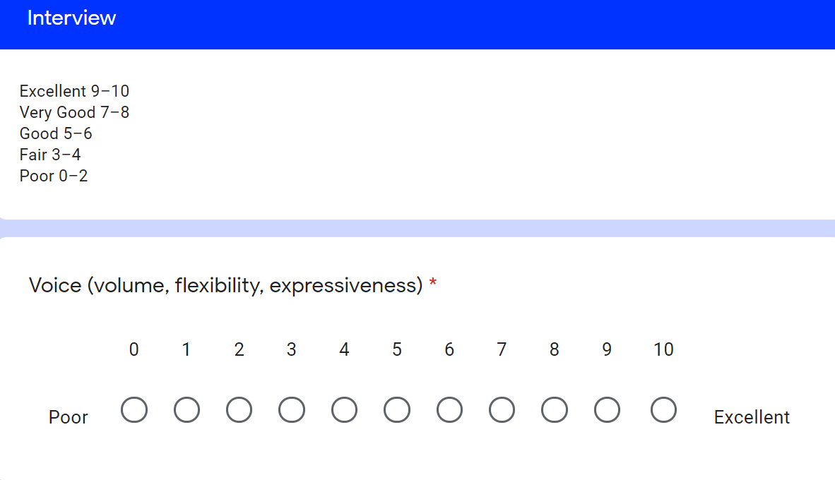
Interview Categories and Scale

Slide 34
Remaining Categories
Language Usage (grammar, enunciation, appropriateness) *
Interpersonal Skills (rapport, interaction, involvement) *
Non-Verbal Language (movement, gesture, posture) *
Manner (assurance, enthusiasm, directness) *
Listening Skills (appropriateness of responses, attentiveness) *
Answering Skills (clear, complete, appropriate) *
Responses (thoughtful, insightful, with conviction) *
Overall Effectiveness (purpose achieved, interest, reception) *
Appearance (appropriate for an interview) *

Slide 35
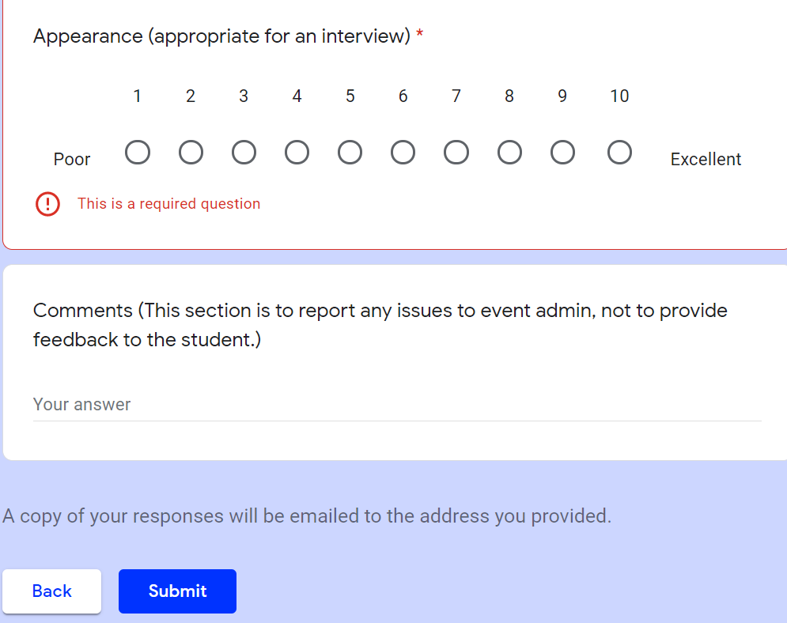
All Categories are Required *

Slide 36
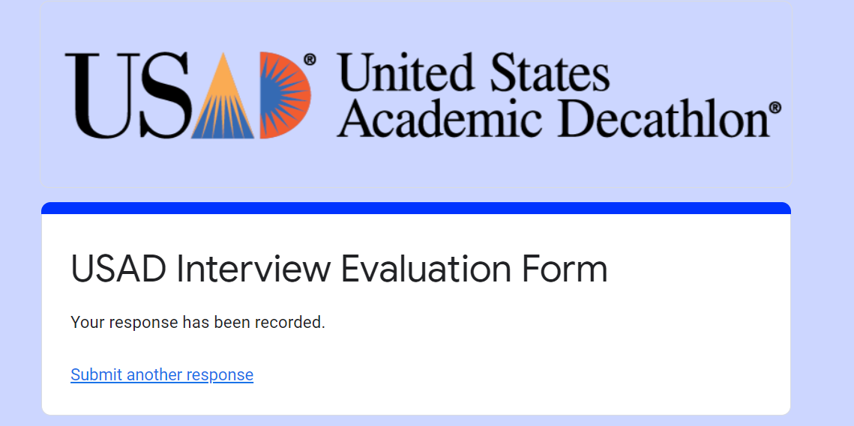
After evaluating each student, select “Submit another response”

Slide 37
Panel Dynamics
Develop a team questioning strategy by preassigning who is asking which of the provided questions (you probably won’t get through all of the question.)
Maintain a rhythm in asking questions.
Evaluate independently; do not confer or share views.
Maintain consistency in your individual judging.

Slide 38
Timing the Interview
The interview itself will last 7 minutes.
Very close to 7 minutes, if a question has just been answered and there is insufficient time to ask and have another answered, the timing judge will close the event
Please ask student to stay seated until the entire room is dismissed

Slide 39
As the Interview begins …
Meet & Greet:
At the scheduled time, the student will enter the room.
Verify the student ID number on scoring screen and schedule
The “welcoming” judge verifies the student id, introduces the interviewing team, and briefly explains the process.
QA with competitor until 7:00 or close is reached.

Slide 40
As the Interview is Ending
After six minutes have elapsed as indicated on the countdown clock:
Allow student to complete answer to current question.
Judge 1 will signal that the interview is over by thanking the student for their participation and wishing them well in the rest of the competition.
DO NOT comment specifically on the student’s performance or provide any indication of his/her score.

Slide 41
Scoring the Interview (after student has left your table)
You will have 3 minutes to score:
Evaluate the student using the Google Form.
Verify the student ID before submitting.
Consider a “6” as the base, and then move up (7-10) or down (5-1) from there (and for each category) when scoring.
You will be unable to “Submit” without all scores
REMEMBER
Judges must not collaborate or compare notes.

Slide 42
Looking at the Rubric
Rubrics provide a means for quantifying intangibles such as responsiveness, warmth, facility, genuineness, and sincerity.
Evaluate the student in each of the rubric categories.
Students should be practiced but personable.

Slide 43
Rubric Categories
VOICE is the way a speaker controls volume, clarity, and distinctness of voice to gain greater audibility. Strong voice implies control of:
rate
volume
pitch
Effective voice control is essential for maintaining interest, holding attention, and conveying self-assurance.

Slide 44
Rubric Categories (cont.)
LANGUAGE USAGE refers to the:
appropriate choice of words
proper use of grammar
correct enunciation
Language should promote a clear understanding of ideas and be appropriate for the occasion.

Slide 45
Rubric Categories (cont.)
INTERPERSONAL SKILLS are measured by a candidate’s ability to establish rapport with interviewers.
The candidate’s response should correspond to and interact with the interviewers’ questions, and should stimulate an involvement with the interviewers.

Slide 46
Rubric Categories (cont.)
NON-VERBAL LANGUAGE refers to the manner in which the candidate effectively uses
gestures
facial expressions
physical involvement (loosely scored in a virtual environment)

Slide 47
Rubric Categories (cont.)
MANNER is measured through the candidate’s ability to speak with:
enthusiasm
confidence
assurance
Student should be fully engaged and enthusiastic about the interview process. The candidate should be direct in their response.

Slide 48
Rubric Categories (cont.)
LISTENING SKILLS refers to the ability to analyze and interpret “what is being asked.”
The candidate’s responses to the questions will give an indication of their level of attention and their ability to identify, sort, and process the information being requested.

Slide 49
Rubric Categories (cont.)
ANSWERING SKILLS refers to the ability to:
address the question directly
present information in a clear and concise manner
organize information in a logical and sequential order
provide responses appropriate for the audience
pace conversation to convey necessary information and achieve purpose
Order, logic, imagination, intelligence, and other personal qualities are reflected in the way answers are given. All information presented should be relevant to the question being asked.

Slide 50
Rubric Categories (cont.)
RESPONSES refers to the quality of the answers given; the candidate should provide thoughtful and insightful responses.
A well-thought-out answer engages the interviewers’ attention and gives insight into the candidate’s personal qualities, skills, goals, and experiences.
Relevant examples and illustrations support the answers. The candidate should speak with certainty and conviction.

Slide 51
Rubric Categories (cont.)
OVERALL EFFECTIVENESS measures the:
nature of information provided
manner in which it was communicated
overall impression it created
rapport established between interviewer and candidate
Some questions to consider:
Did the candidate provide the information requested in a skillful manner?
Was the information relevant and meaningful?
Was the candidate able to achieve a positive impression of their skill, experiences, and personal qualities?

Slide 52
Rubric Categories (cont.)
APPEARANCE refers to the appropriate attire of the candidate. The candidate follows USAD dress standards in choosing attire that is appropriate for an interview.
Appearance, including attire, should be professional, the candidate presenting their self with intention and toward that professionalism – well groomed and in a blazer or sport coat with a collared shirt and tie, or a buttoned or collared blouse with or without a sweater or jacket
Distracting apparel, including logo t-shirts, etc., are not professional in appearance, and hats/caps of any kind are considered inappropriate.

Slide 53
Thank You!
Thank you again for your help. Without you, this important competition could not occur.
Enjoy yourself. You are going to meet some amazing and impressive young people who are a tribute to our schools.
Everyone at USAD appreciates your time and energy.

